Slide 1
AU Library Services
Elaine Fabbro,
Head, Information Literacy & Public Services

Slide 2
Overview
AU Library collections
Finding Resources
Tutorials
Contact Information

Slide 3
Library Collections
250 + databases
150,000 + items in physical collection
150,000 + e-books accessible through library catalogue
~ 70,000 journals

Slide 4
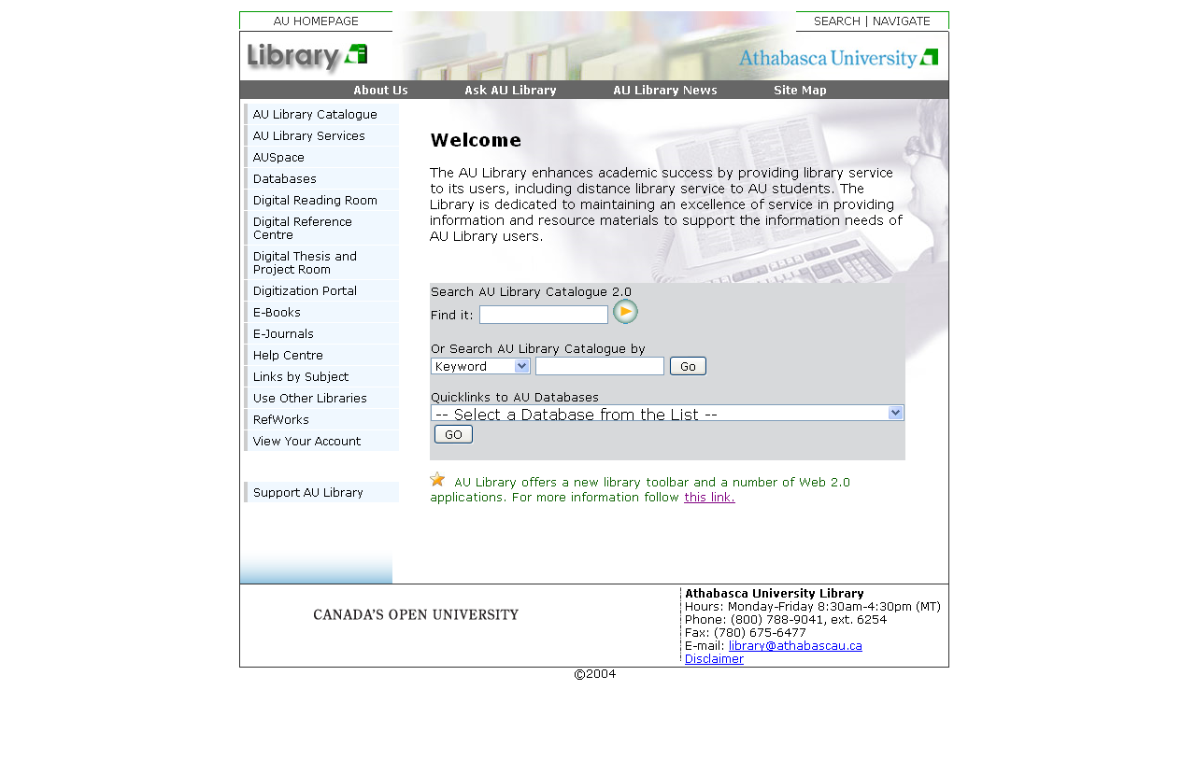
Library Home Page: (http://library.athabascau.ca)

Slide 5
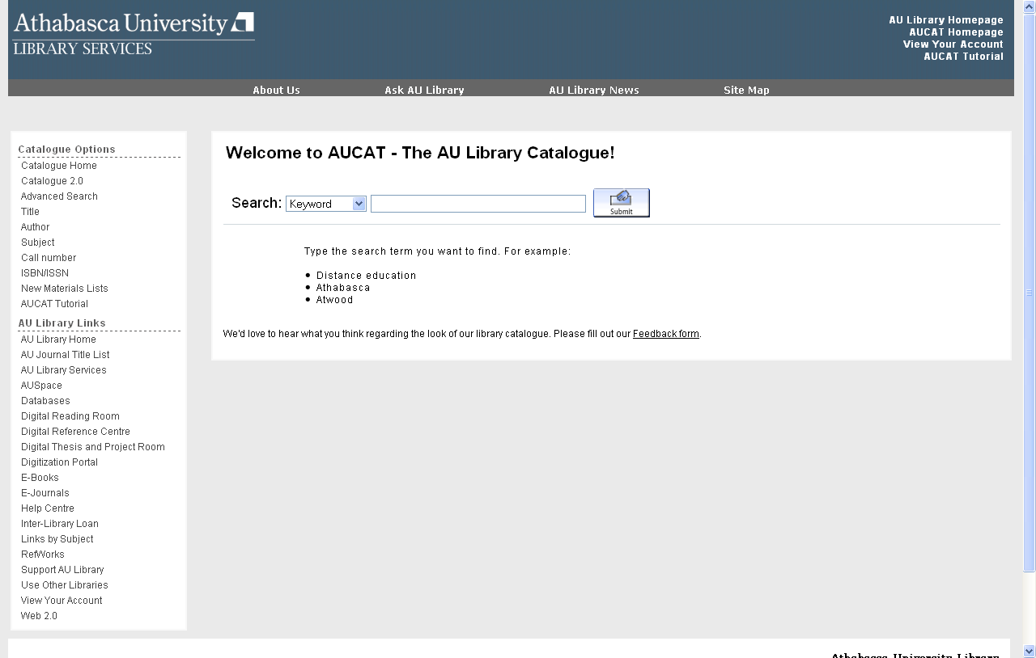
Library Catalogue (http://aupac.lib.athabascau.ca)

Slide 6
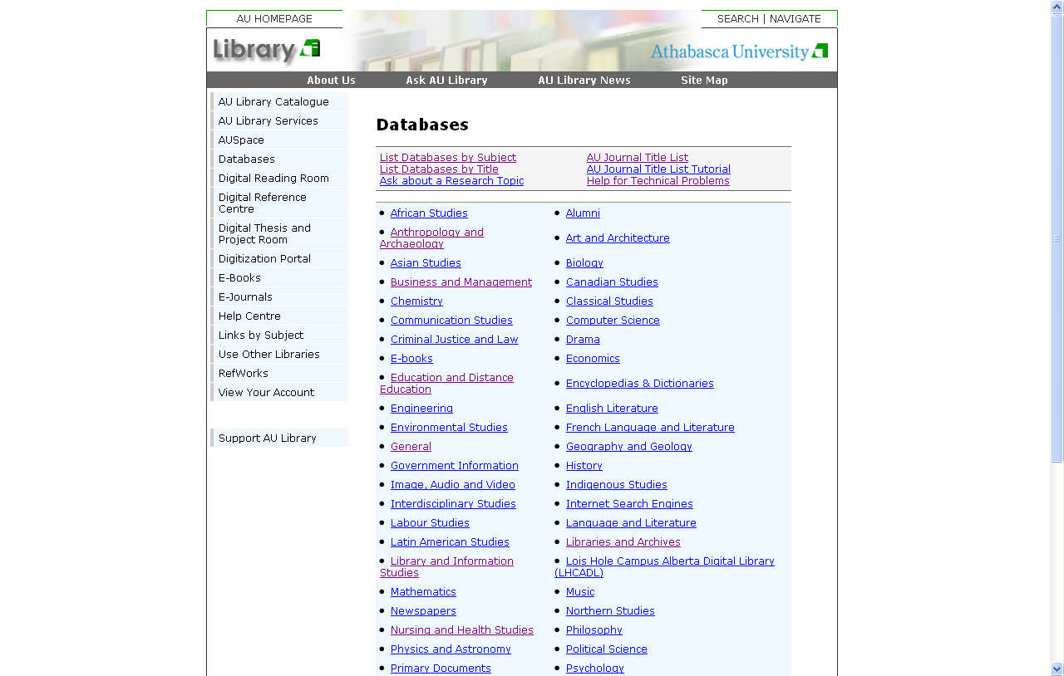
Databases (http://library.athabascau.ca/journals/index.php)

Slide 7
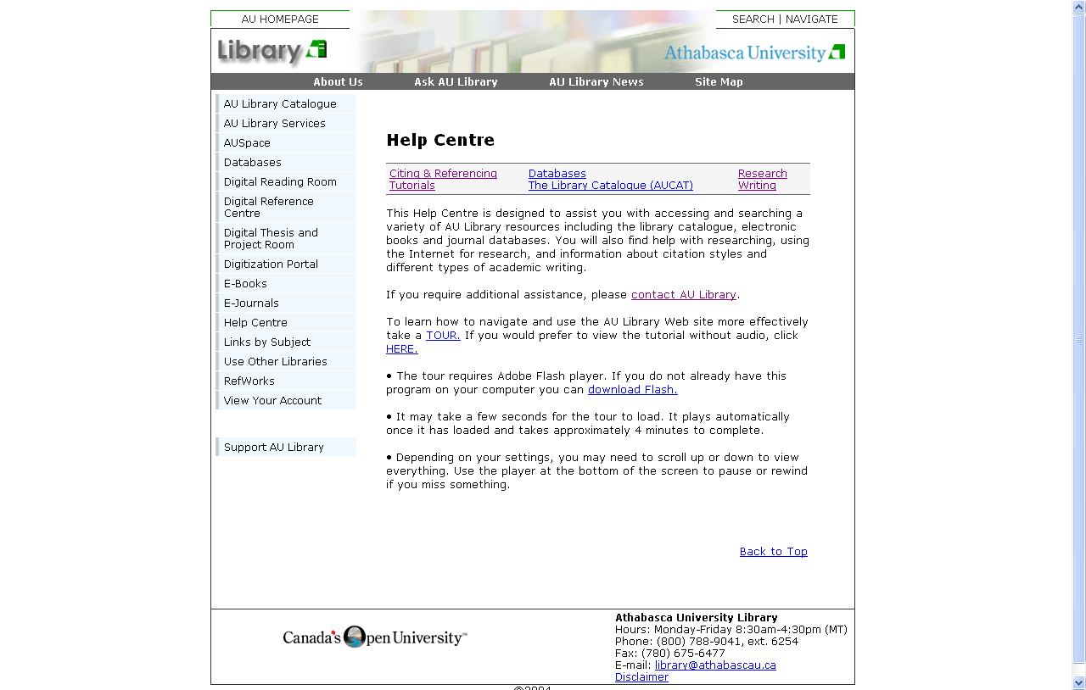
Tutorials
Help Centre: (http://library.athabascau.ca/help.php)

Slide 8
Useful Tutorials
AU Library Tour (http://library.athabascau.ca/help/librarytourmay22audio_viewlet_swf.html)
AUCAT tutorial (http://aupac.lib.athabascau.ca/screens/help_index.html)
AU Journal Title List Tutorial (http://library.athabascau.ca/help/jportal/ejportal_viewlet_swf.html)
Boolean Search Guide (http://libguides.athabascau.ca/booleansearching)
Setting Preferences in Google Scholar (http://library.athabascau.ca/help/tutorials/gsa.html)

Slide 9
Contact Information
Elaine Fabbro
Email: elainef@athabascau.ca
Telephone: 1-800-788-9041, ext. 6819
Library:
Email: library@athabascau.ca
Telephone: 1-800-788-9041, ext. 6254

